Slide 1
Hoshin Bowler Workshop

Slide 2
Purpose & Learning Objectives
Purpose:
To familiarize on the mechanics of creating an effective Hoshin Action Plan. This virtual training will assure Members a more efficient, meaningful, and productive Hoshin experience when in the IMPLEMENT phase of their respective Hoshin AIPs.
Learning Objectives:
Participants will learn the various steps in creating their Hoshin Action Plans, including the following:
Definition of a Bowler
How the Bowler monitors progress to the 2nd Level Hoshin Matrices
Setting the right measurements

Slide 3

7 Phases of the Hoshin Process
Based on the Deming Cycle - PDCA
Develop LRP
Plan
Develop Long-Term Stretch Objectives
Catchball
Do
Check
Act
Develop AIPs, Targets Top Level
Develop AIPs, Targets, Resources - 2nd Level
Targeted
CI Efforts
8D
Counter-
measures
Implement AIPs
Monthly PDCA Review
We are here!
Annual Review
QUESTION: Where could be the failure point in your organization?
Notes:
DO: BREIFLY walk the group through this chart noting that you will be taking them through each step in the process in great detail. Key points to stress:
Strategic Deployment is a PROCESS.
The SD process is mirrored after the PDCA cycle.
You must do ALL of the steps to be successful.
Most companies fail by not implementing steps 5 & 6.
Just because you “Planned” does not mean you did SD.
Note the considerable amount of steps in “Plan” vs. other steps. This is typically a Japanese philosophy where they will spend more time in Planning and a small amount of time in the execution (DO) stage. This is sometimes the opposite thinking of traditional Western management.
SAY: “This cycle is based on the Deming Cycle, or the Plan-Do-Check-Act cycle. When leading with Strategic Deployment your business and its processes will continuously be at different points of implementing this cycle. Notice that it is a cycle (and there are cycles within the cycle) because continuous improvement never ends.

Slide 4
Hoshin Bowler Defined
Definition
Characteristics
Pitfalls
An integral performance tracking tool that monitors, on a monthly basis, Hoshin targets to plan
Used to plan and identify key trends
Provides a visual means to quickly assess plan deviations
Typically, one Bowling Chart for each 2nd Level Hoshin Matrix
Corresponding Top Level Targets are tracked on the 2nd Level Bowling Chart to assess the CAUSE & EFFECT impact on Top Level Targets
Targets are derived from the 2nd Level Hoshin Matrix and articulated on the Bowling Chart in a 12-month timeframe
ACTUALS are tracked to PLAN and highlighted either as RED or GREEN for misses or achieving plan
Jumping Off Point (JOP) does not represent the current state of process performance (more later)
PLAN targets are spread on a 1/12th basis, not taking into consideration major events or seasonality during the year.

Slide 5
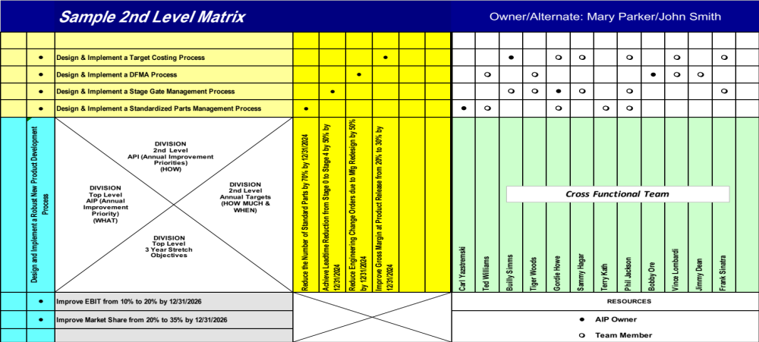
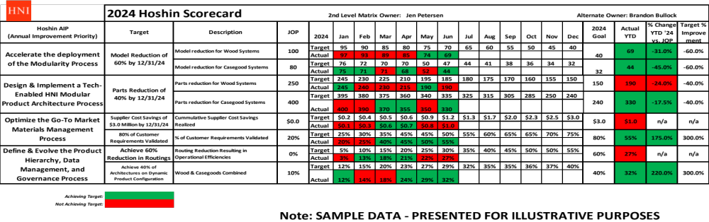
The Relationship Between the 2nd Level Matrix and the Hoshin Bowler
Caution: Only the Targets from the 2nd Level Matrix Belong on the Bowler!

Slide 6
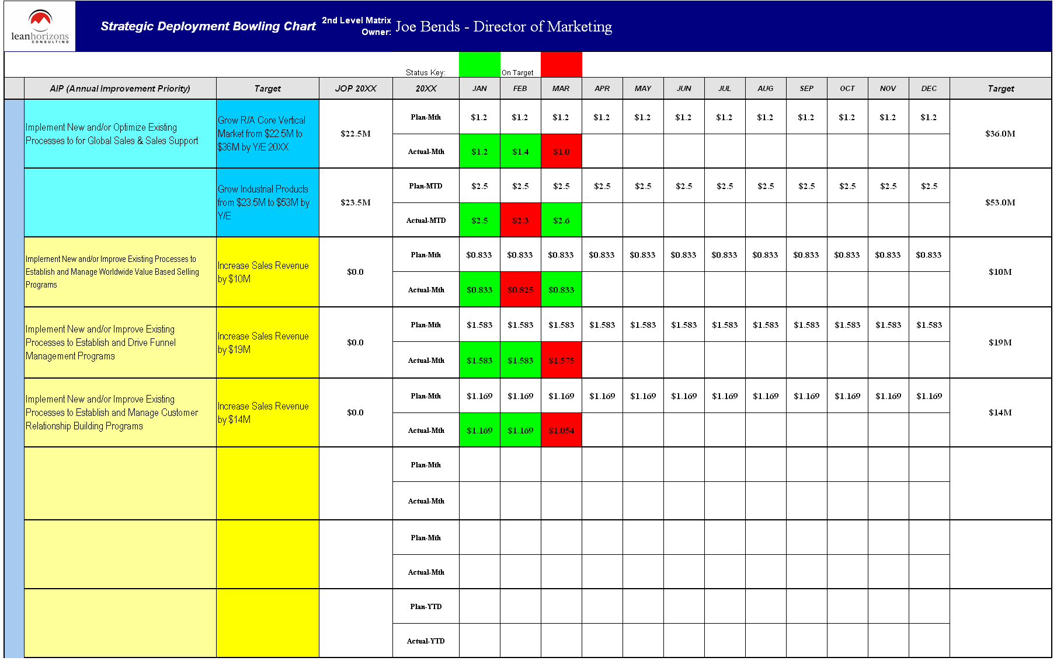
Anatomy of a Bowling Chart
1
Transfer corresponding AIP(s) from the matrix.
2
Transfer corresponding Target from the matrix.
1
2
3
4
5
Jump -off Point: Performance measurement of the process at the beginning of the planning year.
3
4
Plan vs. Actual
5
Target ending point.
6
6
Color Codes:
Green – On Plan
Red – Behind Plan

Slide 7
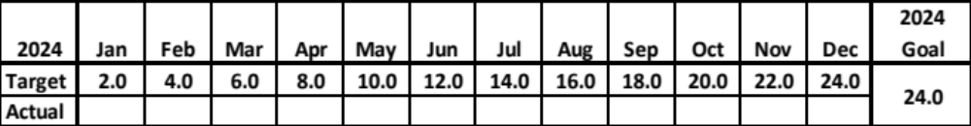

Typical Scenarios You May Encounter
SCENARIO #1 - Plan is evenly distributed throughout the planning period:
SCENARIO #2 - Plan is expecting a significant event in May:

Slide 8
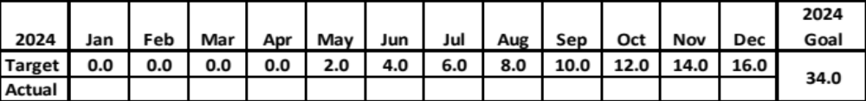
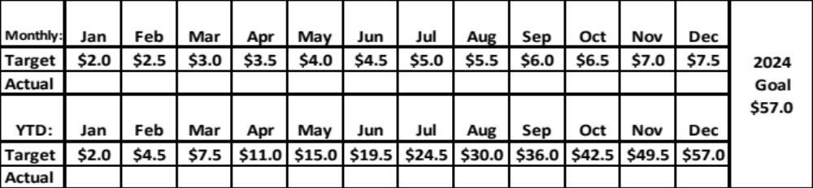
Typical Scenarios You May Encounter - Con’t
SCENARIO #3 - Process is under development with no planned results until May:
SCENARIO #4 - In addition to monthly targets, it may be useful to use Year-To-Date Calculations when cumulative results are meaningful:

Slide 9

Bowling Checklist
The Bowler Should…
Tied to a First-Level AIP
Used to track progress of the implementation of breakthrough objectives
Does the improvement to the measure impact the Top-Level targets

Slide 10

Final Though
You have planned the work and set the measurements, now, you must work the plan!
The key to success is the focus of the AIP team to achieve the targets

